Slide 1

Memory hierarchy
Presentation by:
Aashish Subedi

Slide 2


Table of contents:
o1.
Intro to Memory Hierarchy
o2.
Memory Hierarchy
o3.
Internal Memory
o4.
Primary Memory
o5.
Secondary Memory
o6.
Tertiary Storage

Slide 3
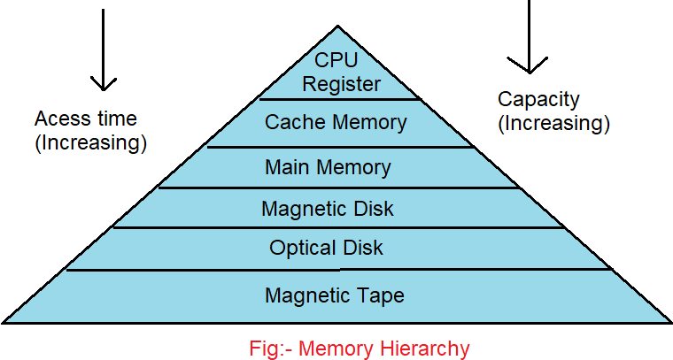
Memory hierarchy
Arrangement: Memory hierarchy organizes memory types from fastest and smallest to slowest and largest.
Efficiency: It balances speed, cost, and capacity to optimize system performance.
Levels: Includes registers, cache, RAM, and secondary storage, each serving different access needs.

Slide 4
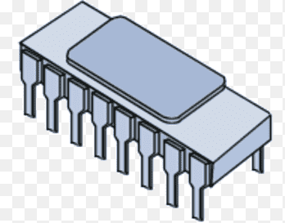
Internal Memory: a)Registers
Fastest Memory: Registers are the quickest memory within the CPU.
Small Size: They store small amounts of data, usually a few bytes.
Immediate Use: Registers hold data currently being processed by the CPU.

Slide 5

Internal Memory: a)Cache Memory
Fast Access: Cache speeds up CPU data retrieval.
Small Storage: Holds frequently used data for quick access.
Reduces Latency: Cache minimizes delays by keeping critical data close to the CPU.
Fig: Cache Memory

Slide 6

Primary Memory a)Main Memory
Primary Storage: Main memory (RAM) is the primary working storage for the CPU, holding data and programs currently in use.
Volatile: It is volatile memory, meaning data is lost when the power is turned off.
Faster than Storage: Main memory is faster than secondary storage but slower than cache memory.
Example: Ram

Slide 7
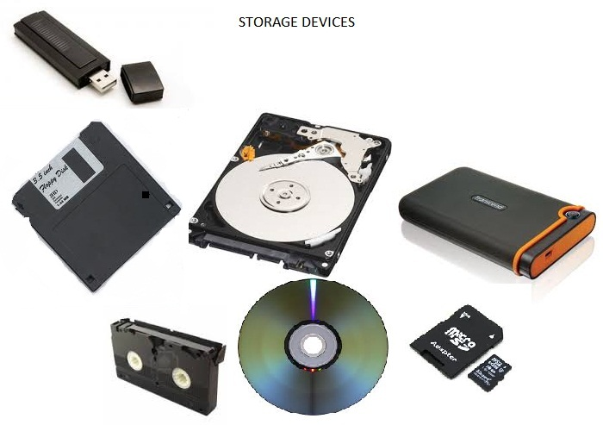
Secondary Memory USB/Flash Memory
Secondary
Points to be note
One
Non-Volatile: USB/Flash memory retains data even when the power is off.
Portable: It's compact and easily transportable, making it ideal for data transfer.
High Capacity: Offers significant storage space for files, though slower than primary memory.
Two
Three
Fig: Secondary Storage Devices

Slide 8
Secondary Memory Magnetic disc/hard drive.
Secondary
Points to be note
One
The storage capacity is in Tera Bytes (TB).
It is a type of secondary memory that is a flat disc covered with a magnetic coating to hold information.
It is flat circular plates made of aluminum or glass and coated with a magnetic material.
Two
Three
Fig: Secondary Storage Devices

Slide 9

Tertiary Storage device Magnetic Tapes/Tape device
o1.
Magnetic tape can store a large amount of data, up to 15 terabytes per tape. This makes it a good choice for digital records and archives.
o2.
Magnetic tape is economical compared to other storage media.
o3.
Magnetic tape is very durable and can be reused many times. When stored in a suitable environment, tapes can last for decades.
o4.
Magnetic tape stores data offline, which can lower the risk of data loss or theft. Tapes also support encryption, such as Advanced Encryption Standard-256.

Slide 10

Thank you
Aashish Subedi
Please send all questions to:
ashisvlog12@gmail.com

